Slide 1
NYS 4th Grade Science Exam
March 6^{h}, 2018
Presenter: Len Pizza

Slide 2
Structure of Exam
Performance Assessment (3 Stations)
Measurement
Electricity & Magnetism
Kinetic Energy and Force
Written Assessments (2 Parts)
30 Multiple Choice Questions
12-15 Short Answer Questions

Slide 3
Testing Dates
Performance Assessment
Wednesday, May 23rd – Friday, June 1st (One Day Only)
Written Assessment
Monday, June 4th (One Day Only)

Slide 4
Performance Tasks
The performance task consists of 3 hands-on scientific investigations that will check the students ability to measure, test, estimate and predict using scientific reasoning and their knowledge of scientific concepts.
Each student will work alone and is responsible to complete all 3 stations.

Slide 5
Sample Question

Slide 6
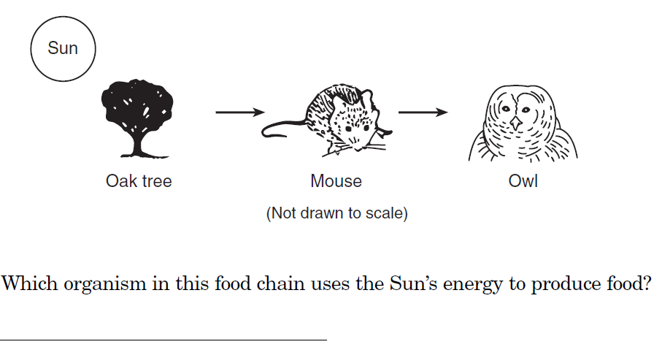
Short Answer Example

Slide 7
Exam Preparation
Students receive a quality science education here at P.S. 174 from kindergarten through 5th grade. The classroom teachers are utilizing text books and students have access to a vast amount non-fiction resources in the classroom library.
Students are receiving STEM Science which provides them with a rich, more in depth, hands-on approach to learning science.

Slide 8
Exam Preparation
Students and parents can access years of past exams that have been given by NYS at: http://www.nysedregents.org/Grade4/Science/home.html . Students will become familiar with the structure of the test and gain practice answering questions.
The following is an interactive online application that presents past science exam questions in a game show format. Many students really seem to enjoy this approach to test prep. http://www.quia.com/rr/66818.html?AP_rand=2048183830

Slide 9
Additional Resources
Barron's New York State Grade 4 Elementary-Level Science Test by Joyce Thornton Barry and Kathleen Cahill

